Slide 1
GUI Unit Testing
Goal:
Test GUI and data types
Import GUI
Test ID | Input | Expected Output/Action | Test
IG1 | Button Press String File Name | Returns message of success to user. Returns message of failure to user. Returns message of failure to user. | Choose a valid STL file and click Import. Choose an invalid STL file and click Import. Choose an invalid file type and click “Import”.
IG2 | Button Press String File Name | Returns message of success to user. | Choose an STL file and click “Delete”.

Slide 2
GUI Unit Testing
Material, Print, Printer, & Extruder
Status
Test ID | Input | Expected Output/Action | Test
XX1 | Button Press String File Name | Updates display | Manually click “New”.
XX2 | Button Press String File Name | Returns message of success to user. Returns message of failure to user. | Insert data of valid type and click “Save”. Insert data of invalid type and click “Save”.
XX3 | Button Press String File Name | Returns message of success to user. | Choose a printer config file and click “Delete”.
Test ID | Input | Expected Output/Action | Test
GS1 | Button Press | Updates display Updates display | Click “pause” button Click “resume” button
GS2 | Button Press | Updates display | Click “Cancel” button.

Slide 3
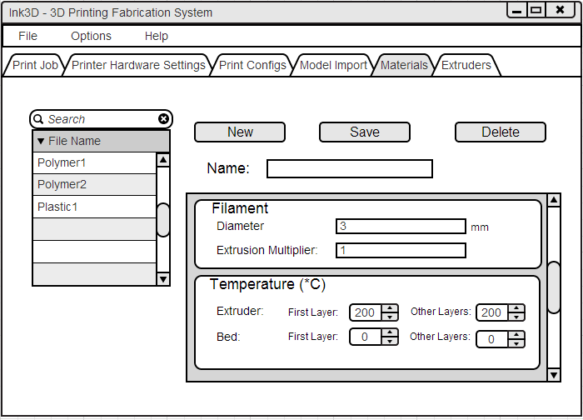
GUI Unit Testing
XX1 - Input
Output:
Display is Cleared

Slide 4
GUI Unit Testing
XX2 - Input
Output:
Notification Message

Slide 5
GUI Unit Testing
XX3 - Input
Output:
Notification Message

Slide 6
GUI Unit Testing
XX1 - Input
XX2 - Input
XX3 - Input

Slide 7
GUI Unit Testing
Print Job
Test ID | Input | Expected Output/Action | Test
GP1 | Button Press String File Name | Updates display | Choose a print job configuration.
GP2 | Button Press | Updates display | Click “New Subsection”.
GP3 | Button Press String File Name Print Job Config Data | Returns message of success to user. Returns message of failure to user. | Insert data of valid type and click “Save”. Insert data of invalid type and click “Save”.
GP4 | Button Press String File Name Print Job Config Data | Returns message of success to user. | Choose a print job file and click “Delete”.

Slide 8
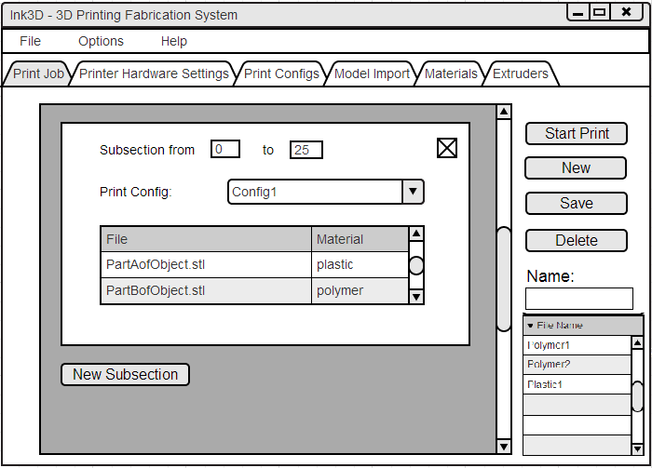
GUI Unit Testing
GP1 - Input
Output: Cleared Fields

Slide 9
GUI Unit Testing
GP2 - Input
Output: Updated Display

Slide 10
GUI Unit Testing
GP3 - Input
Output: Confirmation Message

Slide 11
GUI Unit Testing
GP4 - Input
Output: Confirmation Message

Slide 12
GUI Unit Testing
GP1 - Input
GP3 - Input
GP4 - Input
GP2 - Input

Slide 13
Controller Unit Testing
Goal:
Test function calls and data boundaries
Import
Test ID | Input | Expected Output/Action | Test
IC1 | File Name of STL | Boolean Success state = success Boolean Success state = failure Boolean Success state = failure | Pass a valid STL file to import() Pass an invalid STL file to import() Pass an invalid file type to import()
IC2 | File Name of STL | Boolean Success State = success Boolean Success State = failure | Pass a valid STL file to delete() Pass an invalid file to delete()

Slide 14
Controller Unit Testing
Material, Print, Printer, & Extruder
Test ID | Input | Expected Output/Action | Test
XX1 | String File Name XXX Config Object | Boolean Success State = success Boolean Success State = failure | Pass a XXX Config object with values within boundary tosave() Pass a XXX Config object with values exceeding boundary to save()
XX2 | String File Name | XXX Config Object Error | Pass valid string name to load() Pass invalid string name to load()
XX3 | String File Name | Boolean Success State = success Boolean Success State = failure | Pass valid string name to delete() Pass invalid string name to delete()
XX4 | None | Array List<String> of file names | Call loadAvailableXXXConfigs()

Slide 15
UI Component Testing
GUI
Controller
Test ID | Input | Expected Output/Action | Test
GS1 | Button Presses Text Fields | Updates display with correct results Navigating between menus is easy. (This output is subjective) | Test individual units Tester navigates the menus by clicking the tabs.
Test ID | Input | Expected Output/Action | Test
GC1 | String File Names Object Files | Makes the proper load and save requests with the correct info. | Check how the subsystem handles correct and incorrect data.

